Slide 1
ESTABLISHING CAUSALITY, EXPERIMENTS, PROPENSITY SCORE MATCHING
Dr. Ceren Kolsarici

Slide 2

Agenda for This Session
Establishing Causality
Randomized Marketing Experiments
Propensity Score Matching
Implementing an Experiment – Hands on Exercise

Slide 3
CAUSALITY V. CORRELATION

Slide 4
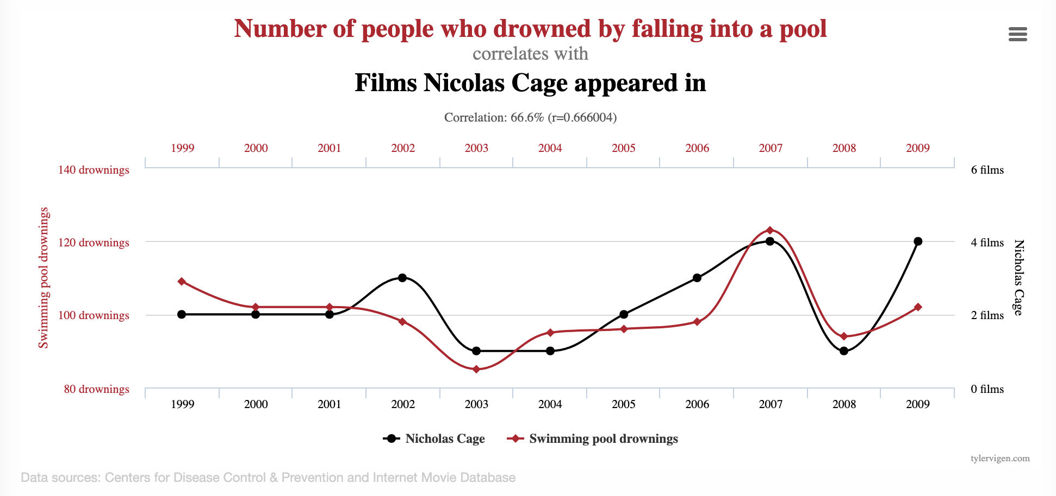
Spurious Correlations Do Exist
Notes:
Spurious Correlations

Slide 5
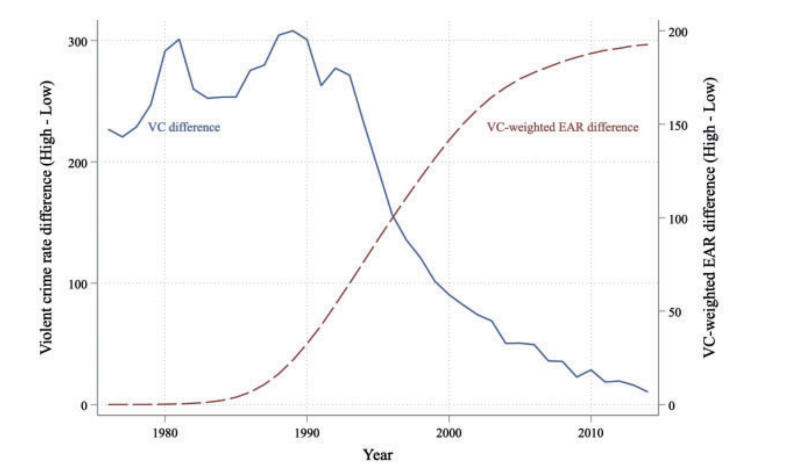
Strong Causal Relationship Between Abortion and Drop in Crime Rates
18 years after Roe v. Wade (1973) violent crime rates started showing a sharp drop nationwide. The effects are stronger for high-abortion states compared to the low-abortion states.
Donohue, J. J., & Levitt, S. (2020). The impact of legalized abortion on crime over the last two decades. American law and economics review, 22(2), 241-302.

Slide 6
Criteria for Establishing Causality
?
SALES
Causality implies the following three criteria:
The independent variable (e.g., ad) and dependent variable (e.g., sales) co-vary.
The independent variable antecedes the dependent variable (i.e., time sequence).
There are no other explanations for the effect between the independent and dependent variable (i.e., no confounding variables).
Randomization

Slide 7
RANDOMIZED CONTROL TRIALS

Slide 8
General Idea
The subjects in the treatment and control groups are similar in all aspects besides the treatment.
This should be accomplished when using random assignment.

Slide 9
Let’s design a Field Experiment
You are the brand manager for a home appliances manufacturer and responsible for the company’s new line of energy efficient refrigerators.
Recently, your TV advertising budget has been a point of contention with the CFO questioning whether if you really need an annual TV advertising budget of $ 5 million dollars.
You argued that the TV ads are critical for brand recall and sales. However, others wanted to know if you have any evidence to back up that statement.
You said “no”, and conceded that it is a hypothesis of yours. However, you also proposed that you could run an experiment to test your hypothesis.

Slide 10

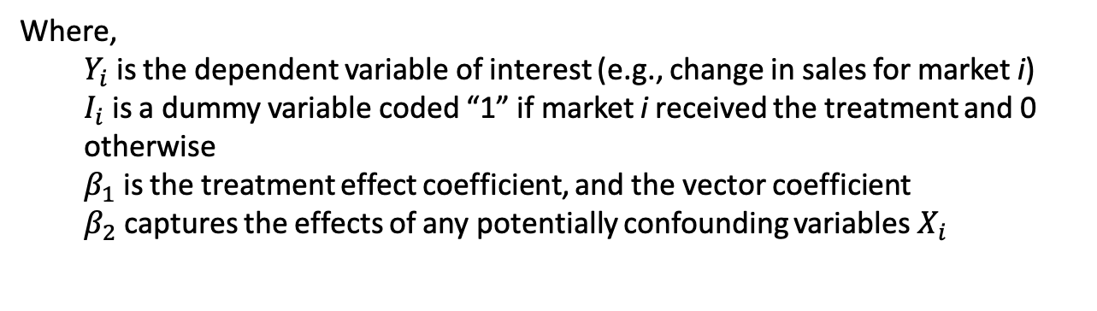
Analyze the Results
$$Y_{i}=β_{1}I_{i}+ β_{2}X_{i}+ ε_{i}$$
Where,
$Y_{i}$ is the dependent variable of interest (e.g., change in sales for market i)
$I_{i}$ is a dummy variable coded “1” if market i received the treatment and 0 otherwise
$β_{1}$ is the treatment effect coefficient, and the vector coefficient
$β_{2}$ captures the effects of any potentially confounding variables$X_{i}$
The treatment effect was positive and significant. The regression equation showed that the 10% increase in TV ad spending resulted in a 4% increase in brand recall and a 3% increase in sales.

Slide 11
Controlling for All Confounding Factors is Difficult
Sometimes experiments occur naturally.

Slide 12
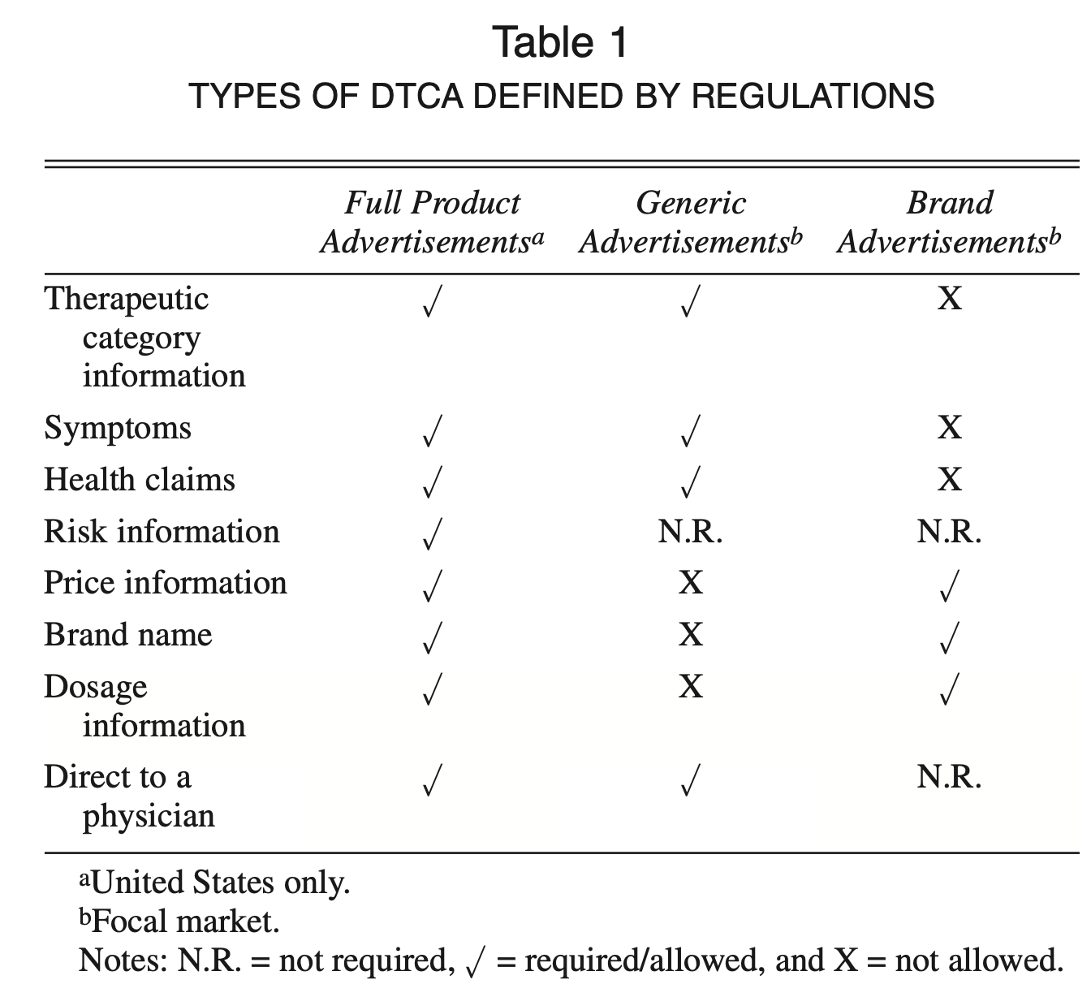
Example: Natural Experiments
When market conditions dictate treatment and control groups due to regulations
Kolsarici, C., & Vakratsas, D. (2010). Category-versus brand-level advertising messages in a highly regulated environment. Journal of Marketing Research, 47(6), 1078-1089.

Slide 13
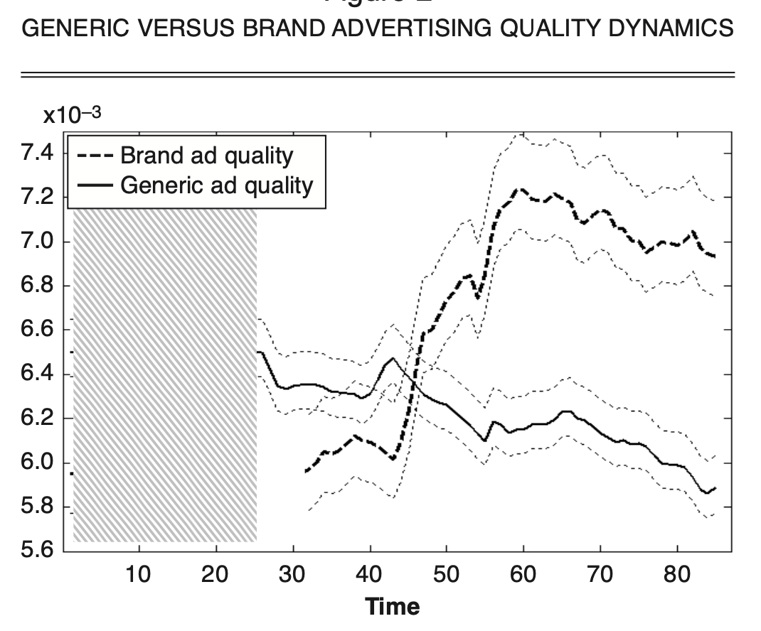
Estimate the Isolated Effects of Category vs. Branded Advertisements
Kolsarici, C., & Vakratsas, D. (2010). Category-versus brand-level advertising messages in a highly regulated environment. Journal of Marketing Research, 47(6), 1078-1089.

Slide 14
Propensity score matching
Accounting for confounding factors beyond control

Slide 15
Not All Confounding Factors are Controllable
Let’s think back to the TV ad example.
Randomly pick 50 markets for treatment (i.e., show the TV campaign) and 50 for control (i.e., don’t show the TV campaign).
What could be some factors that would still make our causal inferences invalid?
When experimental designs are imperfect and/or randomization is not feasible, propensity score matching (PSM) can be a good alternative to still allow researchers to make quasi-causal inferences.

Slide 16
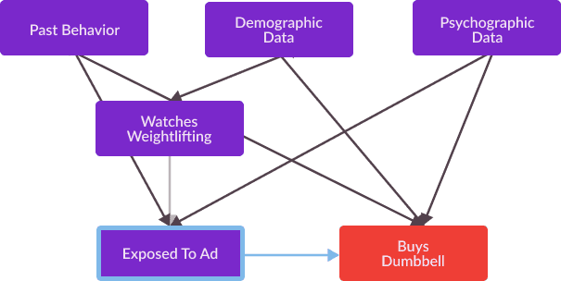
Watches relevant TV channels
Buys Energy Efficient Refrigerator
Full causal graph illustrating a hypothesized relationship between Exposed To Ad and Buys Energy Efficient Refrigerator,
and a variety of confounding variables which affect both variables.

Slide 17
Confounding variables
Watches relevant TV channels
Buys Energy Efficient Refrigerator
We need to identify the confounding variables and hold them constant, but it is a challenge to do this when there is a
large number of confounding variables (i.e., high dimensionality)
Instead, we can transform the impact of these vector of control variables into a scalar, and hold that constant between
treatment and control groups.

Slide 18
Propensity Score Matching Steps
Run a logistic regression model using Treatment condition (i.e., 1 or 0) as the dependent variable and any potential confounding factors as the independent variables.
The predicted value is the probability of each subject being in the treatment group (aka. the propensity score)
For each subject who was in the treatment group, find a “match” (i.e., with a similar propensity score) from the control group
Analyze the results of the experiment using only the treatment group and their matches from the control group.
Your sample size will drop because subjects from treatment and control groups would have to be dropped if no match. But the results would be more accurate.

Slide 19
HANDS ON EXERCISE
Measuring the Causal Effect of an Email Campaign

Slide 20
The Background
The manager of a large multi-channel retail store wants to switch to email marketing to engage customer base and increase sales from more traditional channels like catalogs.
The company wants to do a test run to see the effectiveness of the email channel, but they do not have the emails of all of the customers.
The manager decides to send their new promotion through email to the subset of customers they have the contact information for, even though the sample would likely be biased.
The company wants to measure:
The impact of the email campaign on purchase behavior
The ROI of the email campaign

Slide 21
Data Key
The dataset includes pre- and post-email campaign transactions of your customers, which you can use to measure the average treatment effect for the email campaign.
Variable Name | Definition
Customer | A unique identifier assigned to each of the 27,121 customers in your sample.
Email | A dummy variable equal to 1 if the customer received the email and 0 otherwise.
Purchase_Amt | The amount of revenue received from the customer in the month during the email campaign. The value is 0 if the customer did not make a purchase.
Revenue | The revenue that the customer spent at the company in the past 2 years prior to the email campaign (1/1/2020 to 12/31/2021).
Number_of_Orders | The number of times the customer made a purchase at the company in the past 2 years prior to the email campaign (1/1/2020 to 12/31/2021).
Number_of_Orders2 | Square of the Number_of_Orders
Recency_Days | The time (in days) since the customer has made her most recent purchase at the company before the start of the email marketing campaign.

Slide 22
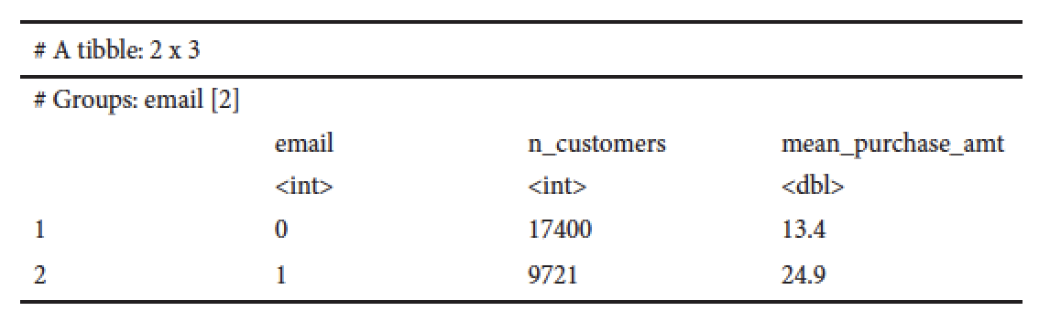
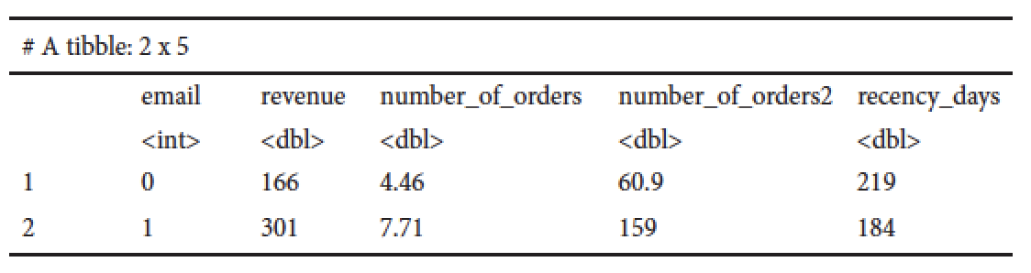
Eyeballing the Data
The average purchase amount of the customers in the treatment group is $11.50 higher than those in the control group.
Can we conclude this is the effect of the campaign?
We need to check if customers in the treatment group are systematically different from the others.
Yes, they are!
We need to run a matching algorithm (i.e., PSM)

Slide 23
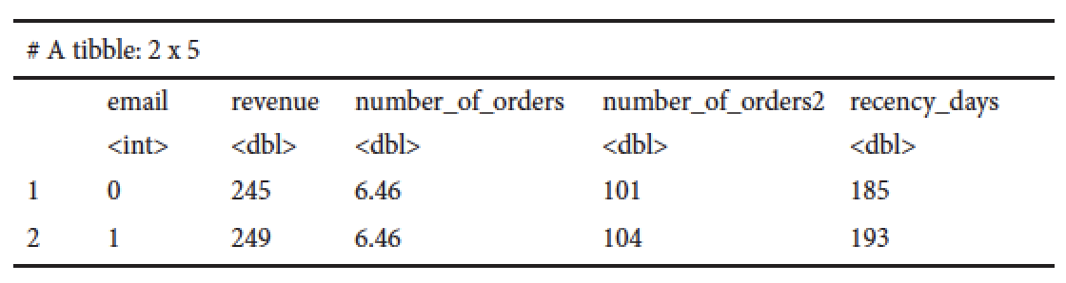
Post PSM Means
Let’s compare the means of the two groups in the matched data set.
Significant improvement in group similarity.
Now we can analyze the effect of the email campaign using the matched data.
Caution needs to be shown to the properties of the data in determining what kind of model would be appropriate for the regression.
The dependent variable, purchase amount, is left-censored consisting only of non-negative values.
Linear regression and OLS would result in biased estimates. Which model handles the cencored DVs?

Slide 24
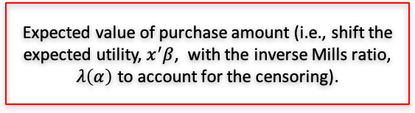
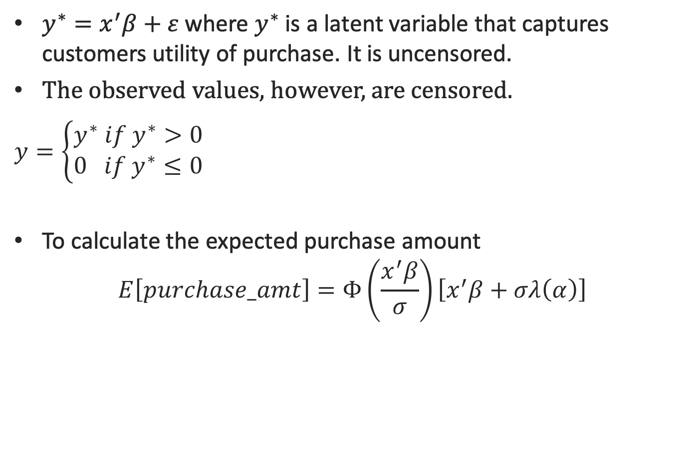
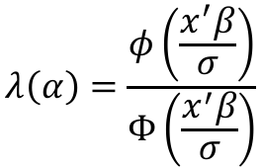
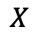
Understanding Tobit Regression
$y^{∗}=x^{′}β+ε$ where $y^{∗}$ is a latent variable that captures customers utility of purchase. It is uncensored.
The observed values, however, are censored.
$y=\left\{\begin{matrix}y^{∗} if y^{∗}>0 \\ 0 if y^{∗}≤0\end{matrix}\right.$
To calculate the expected purchase amount
$$E\left[purchase_amt\right]=Φ\left(\frac{x^{′}β}{σ}\right)\left[x^{′}β+σλ\left(α\right)\right]$$
For negative utilities we do not observe a purchase (i.e., 0), for positive utilities we do.
Expected value of purchase amount (i.e., shift the expected utility, $x^{′}β$, with the inverse Mills ratio, $λ\left(α\right)$ to account for the censoring).
Expected probability to purchase
$$X$$
$$λ\left(α\right)=\frac{φ\left(\frac{x^{′}β}{σ}\right)}{Φ\left(\frac{x^{′}β}{σ}\right)}$$

Slide 25
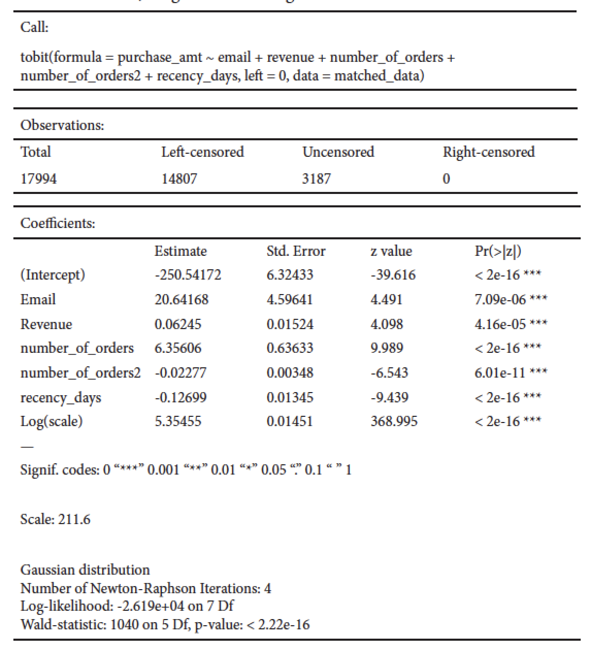
Tobit Results

Slide 26
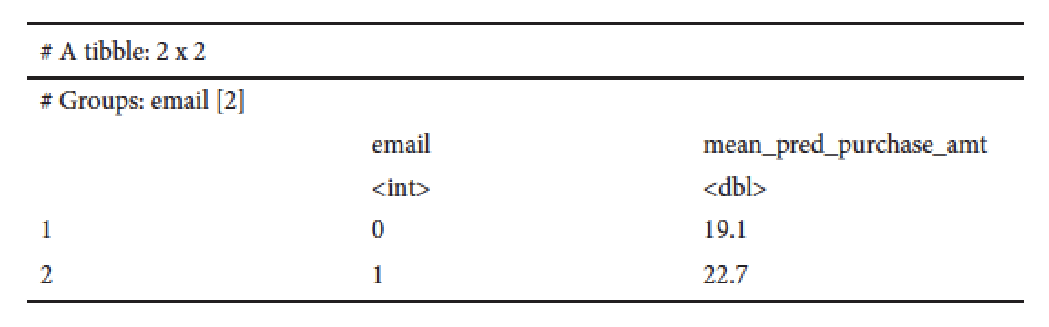
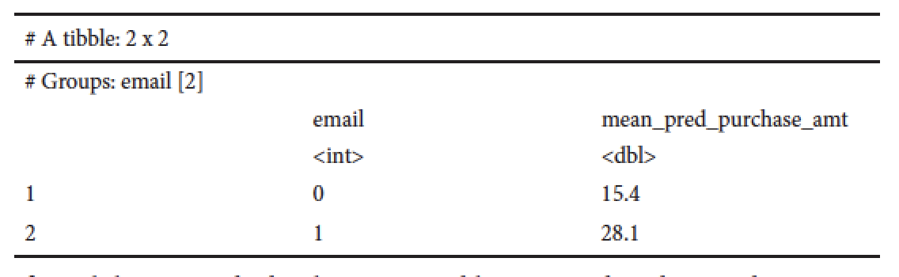
The Lift Due to the Email Campaign
The email increased the expected purchase amount of the email group by about $3.30 when compared to the matched sample of the no email group ($22.70 vs. $19.10).
What if we had done the same exercise with the unmatched data?
We would have overestimated the effect of the email channel by $9.40

